Slide 1
NAIVE BAYES ALGORITHM

Slide 2
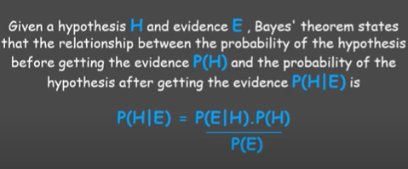
Naive Bayes Theorem:

Slide 3
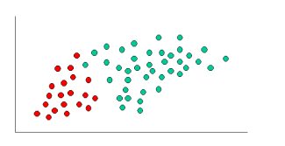
Concept of Naive Bayes Classification:
Prior probabilities are based on previous experience.
Often used to predict outcomes before they actually happen.
Thus, we can write:
Prior Probability of GREEN: number of GREEN objects / total number of objects
Prior Probability of RED: number of RED objects / total number of objects
Since there is a total of 60 objects, 40 of which are GREEN and 20 RED, our prior probabilities for class membership are:
Prior Probability for GREEN: 40 / 60
Prior Probability for RED: 20 / 60

Slide 4
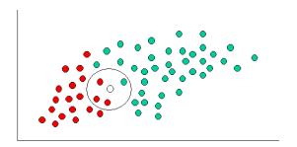
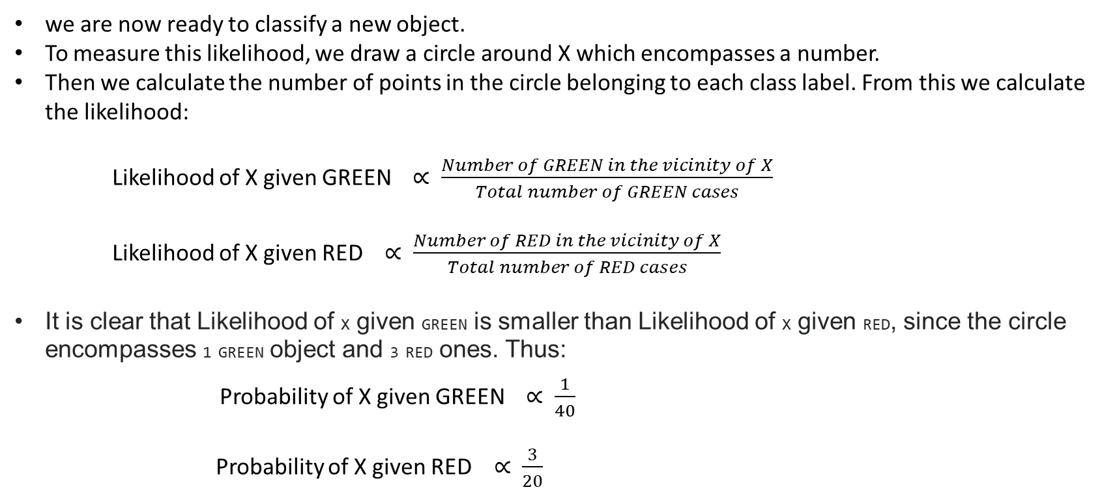
we are now ready to classify a new object.
To measure this likelihood, we draw a circle around X which encompasses a number.
Then we calculate the number of points in the circle belonging to each class label. From this we calculate the likelihood:
Likelihood of X given GREEN ∝ $\frac{Number of GREEN in the vicinity of X}{Total number of GREEN cases}$
Likelihood of X given RED ∝ $\frac{Number of RED in the vicinity of X}{Total number of RED cases}$
It is clear that Likelihood of X given GREEN is smaller than Likelihood of X given RED, since the circle encompasses 1 GREEN object and 3 RED ones. Thus:
Probability of X given GREEN ∝ $\frac{1}{40}$
Probability of X given RED ∝ $\frac{3}{20}$

Slide 5
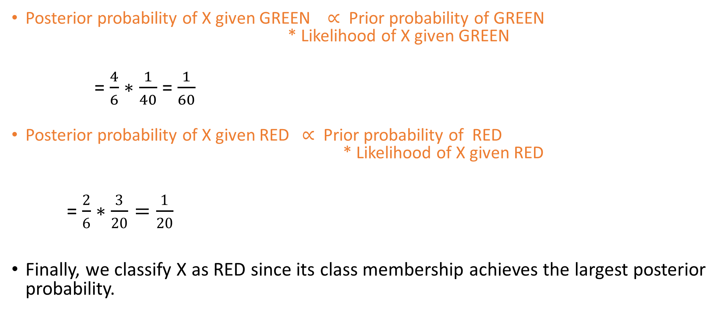
Posterior probability of X given GREEN ∝ Prior probability of GREEN * Likelihood of X given GREEN
= $\frac{4}{6}∗$ $\frac{1}{40}$ = $\frac{1}{60}$
Posterior probability of X given RED ∝ Prior probability of RED * Likelihood of X given RED
= $\frac{2}{6}∗\frac{3}{20}=\frac{1}{20}$
Finally, we classify X as RED since its class membership achieves the largest posterior probability.

